Slide 1
ATAI
Advanced Techniqueof Artificial Intelligence
ATAI
ChongqingUniversity _{AdvancedTechniqueof}
of Technology Artificial Intelligence
Chongqing University of
Technology
Chongqing University ^{ATAI}
_{of Technology} Advanced Techniqueof
Artificial Intelligence
Chongqing University of Technology
Chongqing University of Technology
GRAIN: Multi-Granular and Implicit Information Aggregation Graph Neural Network for Heterophilous Graphs
Code: https://github.com/Songwei-Zhao/GRAIN
2025.4.24 •ChongQing
—— AAAI_2025
Reported by Shiyan Wu
1

Slide 2
ATAI
AdvancedTechniqueof
Artificial Intelligence
ATAI
ChongqingUniversity _{AdvancedTechniqueof}
of Technology Artificial Intelligence
ChongqingUniversity of Technology
Motivation
1. Traditional GNNs, such as GCN, may introduce noise when directly aggregating neighbor information on heterophilous graphs, leading to degraded embedding quality and insufficient performance.
2. Existing GNN methods designed for heterophilous graphs often overlook the differences in information granularity and rarely consider implicit relationships between distant nodes, necessitating multi-granularity aggregation and implicit relationship modeling to improve embedding quality.

Slide 3
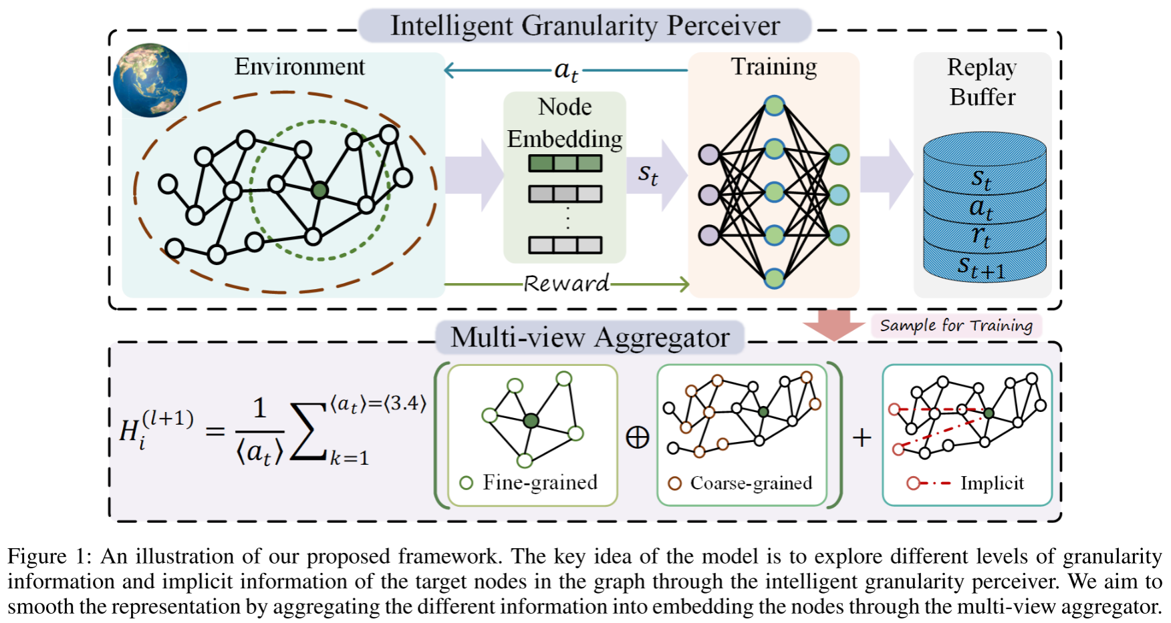
ChongqingUniversity of Technology
ATAI
AdvancedTechniqueof
Artificial Intelligence
ATAI
ChongqingUniversity _{AdvancedTechniqueof}
of Technology Artificial Intelligence
Overview

Slide 4
ChongqingUniversity of Technology
ATAI
AdvancedTechniqueof
Artificial Intelligence
ATAI
ChongqingUniversity _{AdvancedTechniqueof}
of Technology Artificial Intelligence
Method

Slide 5
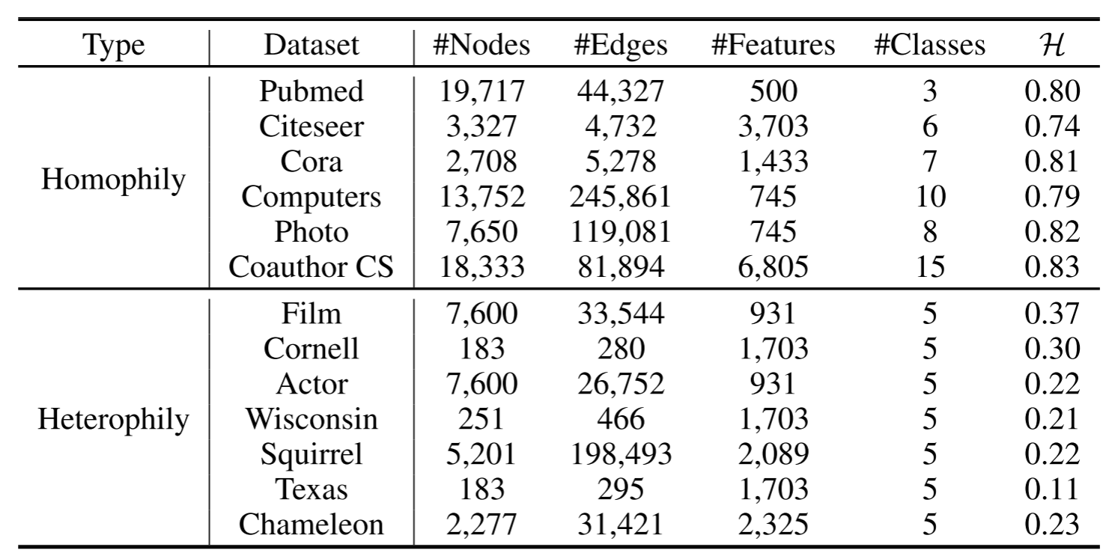
ATAI
AdvancedTechniqueof
Artificial Intelligence
ATAI
ChongqingUniversity _{AdvancedTechniqueof}
of Technology Artificial Intelligence
ChongqingUniversity of Technology
Experiments

Slide 6
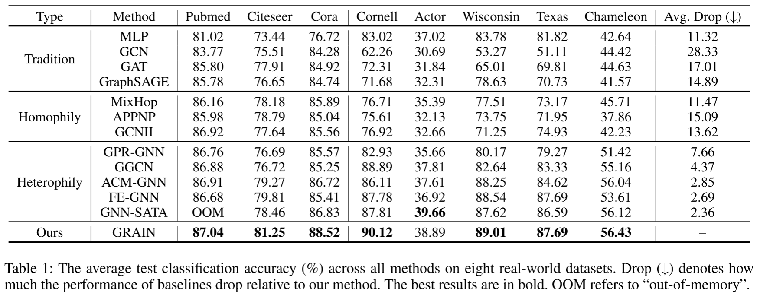
ATAI
AdvancedTechniqueof
Artificial Intelligence
ATAI
ChongqingUniversity _{AdvancedTechniqueof}
of Technology Artificial Intelligence
ChongqingUniversity of Technology
Experiments

Slide 7
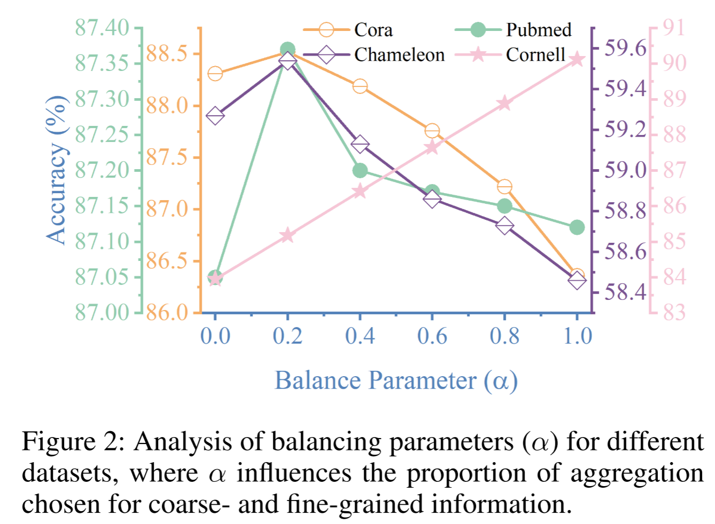
ATAI
AdvancedTechniqueof
Artificial Intelligence
ATAI
ChongqingUniversity _{AdvancedTechniqueof}
of Technology Artificial Intelligence
ChongqingUniversity of Technology
Experiments

Slide 8
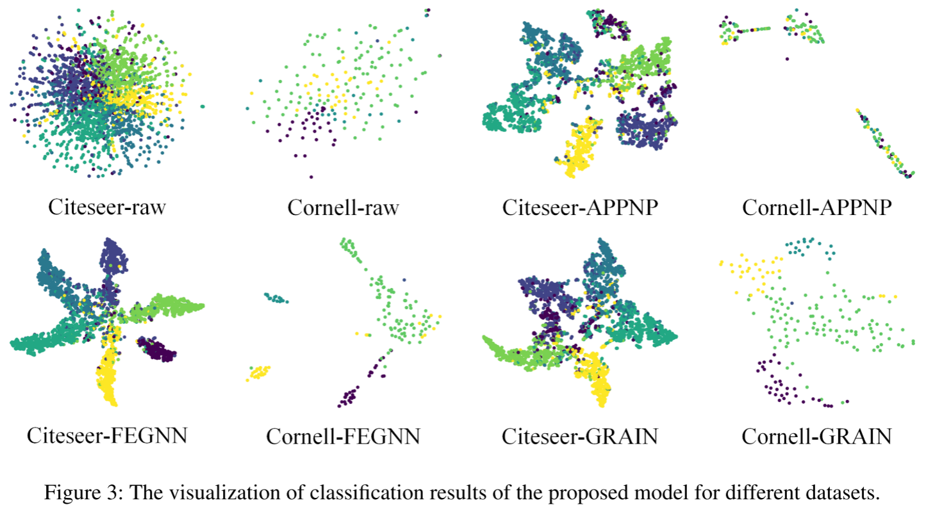
ATAI
AdvancedTechniqueof
Artificial Intelligence
ATAI
ChongqingUniversity _{AdvancedTechniqueof}
of Technology Artificial Intelligence
ChongqingUniversity of Technology
Experiments

Slide 9
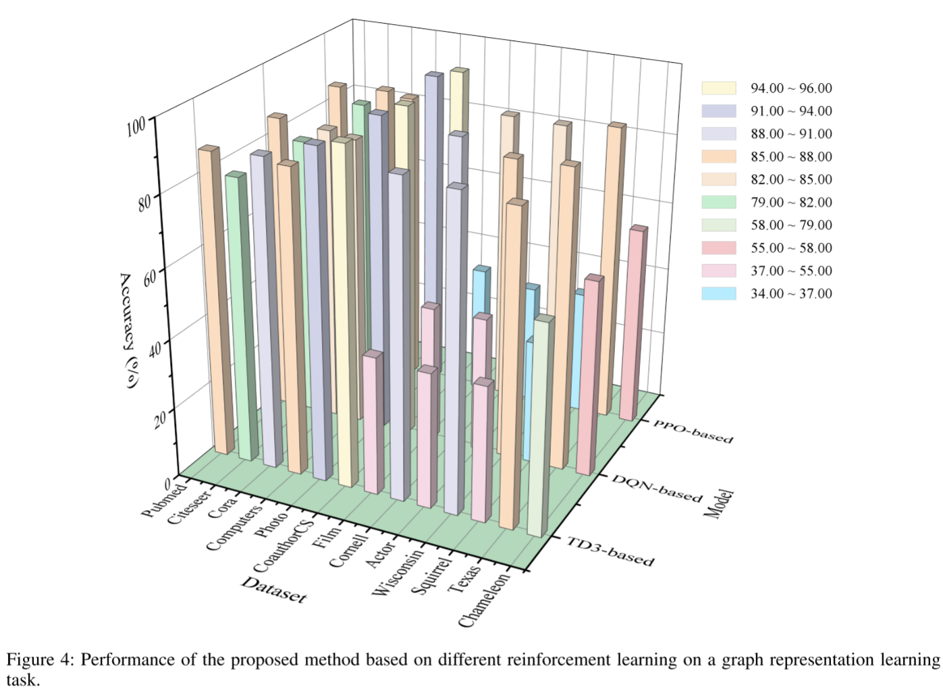
ATAI
AdvancedTechniqueof
Artificial Intelligence
ATAI
ChongqingUniversity _{AdvancedTechniqueof}
of Technology Artificial Intelligence
ChongqingUniversity of Technology
Experiments

Slide 10
ChongqingUniversity of Technology
ATAI
AdvancedTechniqueof
Artificial Intelligence
ATAI
ChongqingUniversity _{AdvancedTechniqueof}
of Technology Artificial Intelligence
Thanks!

